Slide 1
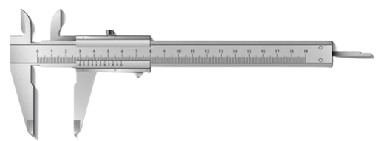
MEASURE phase
Project picture
Project title
Green Belt/Black Belt name:
Date:

Slide 2
Project reminder
Project Context/Business Need/Alignment with Company strategy
[Describe here the context of the project]
Problem Statement
SMART Goal Statement
[What is the current Performance issue in terms of Delay, Cost, Quality? Be SMART (Specific, Measurable, Attainable, Realistic, Tangible)]
[What is the Future Performance Objective of this project in terms of Delay, Cost, Quality? Be SMART (Specific, Measurable, Attainable, Realistic, Tangible)]
In Scope
Out of Scope
[What is in scope of this project?]
[What is out of scope of this project?]

Slide 3
Process map (swim lane)

Slide 4
Measurement system analysis
CTQ measured:
Operational definition of CTQ:
Unit of Measure:
Type of CTQ:
Mean target:
Lower Spec. Limit:
Upper Spec. Limit:
Measurement System:
CTQ measurement system description/picture:

Slide 5
Measurement system analysis (continuous CTQ – 1/2)
Measurement System Accuracy Analysis
CTQ measurement system accuracy analysis (i.e., simple linear regression of measurement of several known standards or manual verification of accuracy of IS data or collected data compared to real data with a sample):
linear regression study chart or data collection form picture here

Slide 6
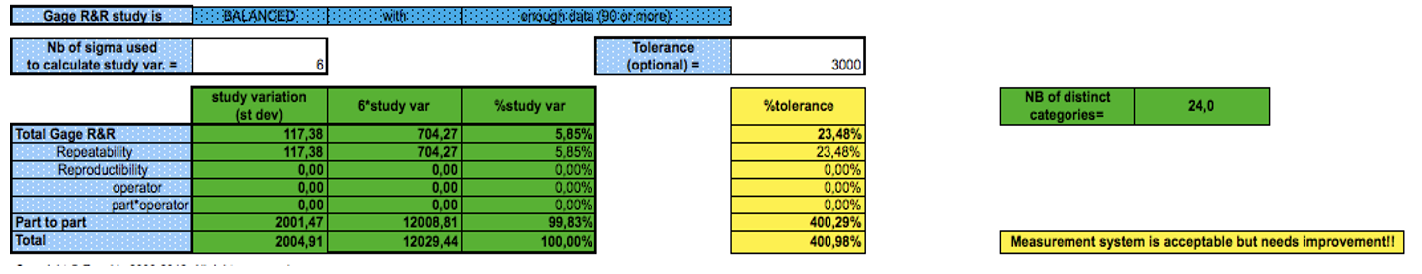
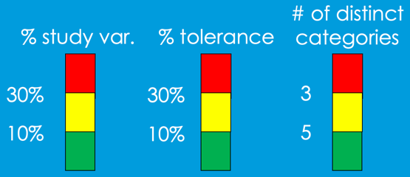
Measurement system validation (continuous CTQ 2/2)
Measurement System Precision Analysis with gage R&R study:
CTQ measurement system precision analysis with gage RR study:
USL=________
LSL=________
Tolerance (USL-LSL)=___________ Unit: _______________
Place your own Gage R&R results picture here
illustrative
your value
your value
your value
CTQ measurement system validation/conclusion:

Slide 7
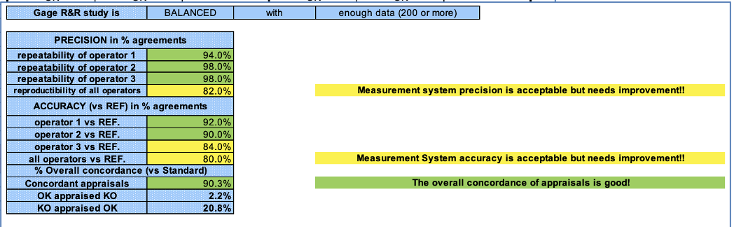
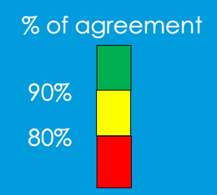
Measurement system validation (attribute CTQ)
Measurement System Accuracy & Precision Analysis with gage R&R study:
CTQ measurement system accuracy and precision analysis with a gage RR study including a reference:
Place your Gage R&R results picture here
illustrative
your value
CTQ measurement system validation/conclusion:

Slide 8
Measurement System Improvement actions
For non-validated measurement system(s) only

Slide 9
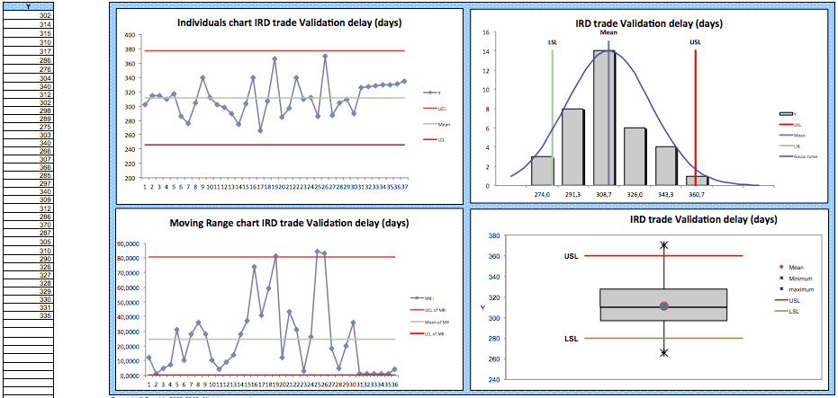
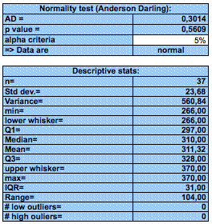
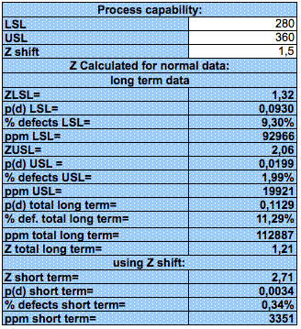
Process capability (continuous CTQ)
illustrative

Slide 10
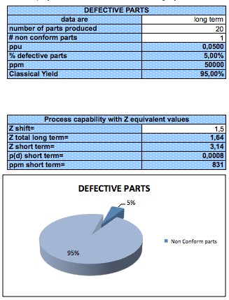
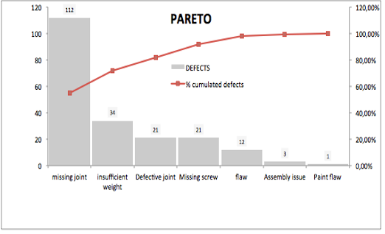
Process capability (attribute CTQ)
illustrative
illustrative

Slide 11
Updated Business Case/Financial Analysis
Hard Benefits over a 12-month period:
Assumptions made:
FTE (Full Time Equivalent) Benefits:
Assumptions made:
Soft Benefits Benefits:
Assumptions made:
Project anticipated costs:
Assumptions made:

Slide 12
Quick Wins/Next Steps

Slide 13
End

