Slide 1


IMPROVE phase
Project picture
Project title
Green Belt/Black Belt name:
Date

Slide 2
Project reminder
Project Context/Business Need/Alignment with Company strategy
[Describe here the context of the project]
Problem Statement
SMART Goal Statement
[What is the current Performance issue in terms of Delay, Cost, Quality? Be SMART (Specific, Measurable, Attainable, Realistic, Tangible)]
[What is the Future Performance Objective of this project in terms of Delay, Cost, Quality? Be SMART (Specific, Measurable, Attainable, Realistic, Tangible)]
In Scope
Out of Scope
[What is in scope of this project?]
[What is out of scope of this project?]

Slide 3
Improvement actions
Problem | Critical Root Cause (Xi) | Solution/Improvement Action (Aj) | Action category (People/Process/Technology)
Y1: abcd | X1: abcd | A1: xyz | People
 | X2: efgh | A2: zzzz | Process
 | X3: ijkl | A3: wwww | Technology
 | X4: mnop | A4: yte | People
 | … | A5: uye | Process
 | … | … | …
 | … | … | …
 | … | … | …
 | … | … | …
 | Xi: | Aj: | People/Technology/Process

Slide 4
Effort/Benefit matrix
Solution/Improvement Action (Aj)
A1: xyz
A2: zzzz
A3: wwww
A4: yte
A5: uye
…
…
…
…
Aj:
Benefit
Action i
Action j
high
Most valuable Actions
Actions to
evaluate
medium
Non valuable Actions
low
Effort
low
medium
high

Slide 5
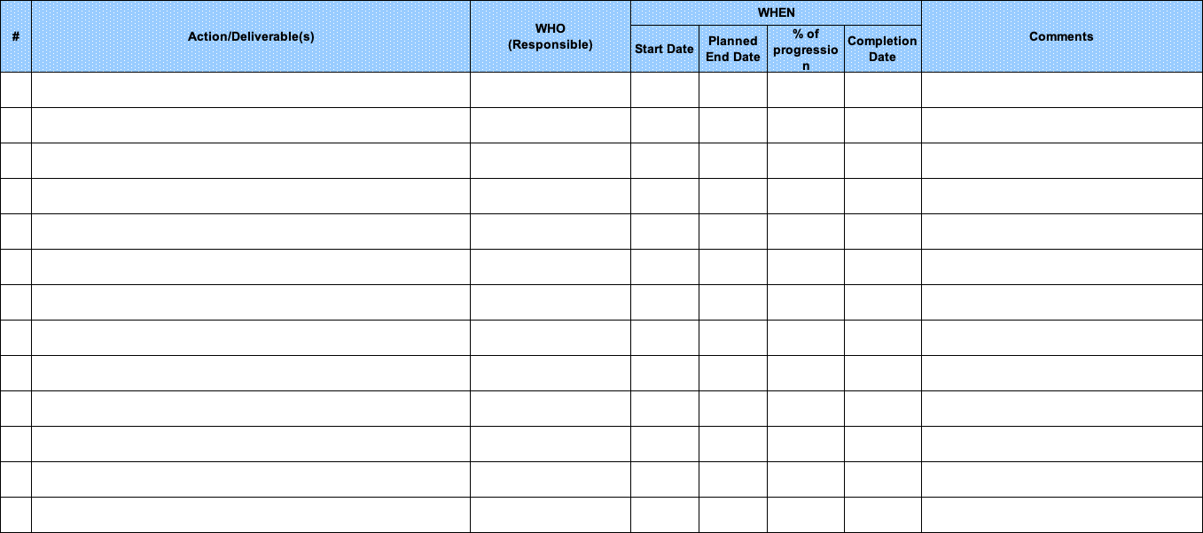
Implementation plan

Slide 6
Improvement action i
Describe Improvement action: _____
Picture before
Picture after

Slide 7
Improvement action i
Describe Improvement action: _____
Picture before
Picture after

Slide 8
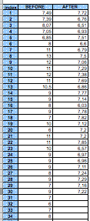
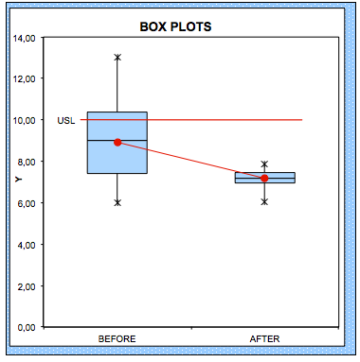
Proof of improvement: Y continuous
Y
  Key takeaway!!

Slide 9
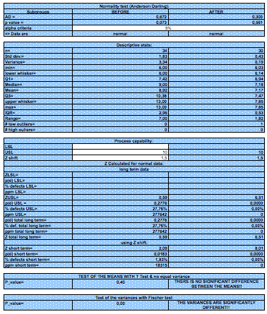
Statistical Proof of improvement: Y continuous
  Key takeaway!!

Slide 10
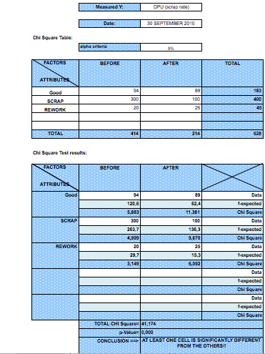
Statistical Proof of Improvement: Y attribute
  Key takeaway!!

Slide 11
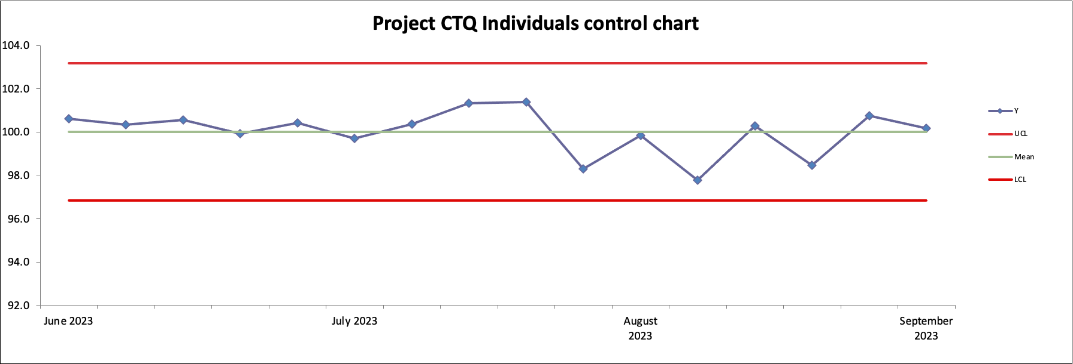
Project CTQ monitoring (before/after Improve)
Example
Before IMPROVE
After IMPROVE

Slide 12
Updated Business Case/Financial Analysis (optional)
Hard Benefits over a 12-month period:
Assumptions made:
FTE (Full Time Equivalent) Benefits:
Assumptions made:
Soft Benefits Benefits:
Assumptions made:
Project anticipated costs:
Assumptions made:

Slide 13
Next Steps

Slide 14
End

