Slide 1

CONTROL phase
Project picture
Project title
Green Belt/Black Belt name:
Date:

Slide 2
Project reminder
Project Context/Business Need/Alignment with Company strategy
[Describe here the context of the project]
Problem Statement
SMART Goal Statement
[What is the current Performance issue in terms of Delay, Cost, Quality? Be SMART (Specific, Measurable, Attainable, Realistic, Tangible)]
[What is the Future Performance Objective of this project in terms of Delay, Cost, Quality? Be SMART (Specific, Measurable, Attainable, Realistic, Tangible)]
In Scope
Out of Scope
[What is in scope of this project?]
[What is out of scope of this project?]

Slide 3
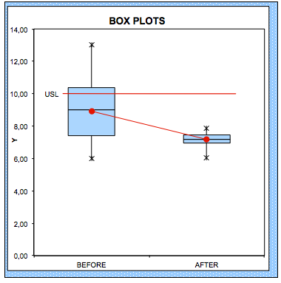
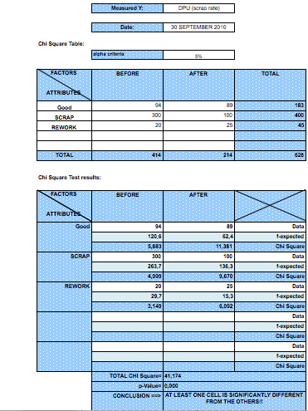
Proof of improvement
Y continuous
Y attribute
Y
  Key takeaway!!

Slide 4
Control plan
  CTQ Monitoring
  Training Plan
  Work Instructions
  Visual Management/Production Run debrief meetings
  RACI
  Audit plan
4 Visual Management
/Production
run
debrief
5 RACI
1 CTQ monitoring
3 Work Instructions
2 Training
Plan
6 Audit
Plan
Notes:
9:26 – 9:27 1’
CAROLE
_ _ _ _ _
1/ There are 5 elements in the Control Plan
2/ This document – this master document should contain,… (read the 5 elements)
Training Plan
Documentation Plan
Monitoring Plan
Response Plan
Alignment of systems & structures
3/ Next: let’s detail each element one by one. We start with the Training plan

Slide 5
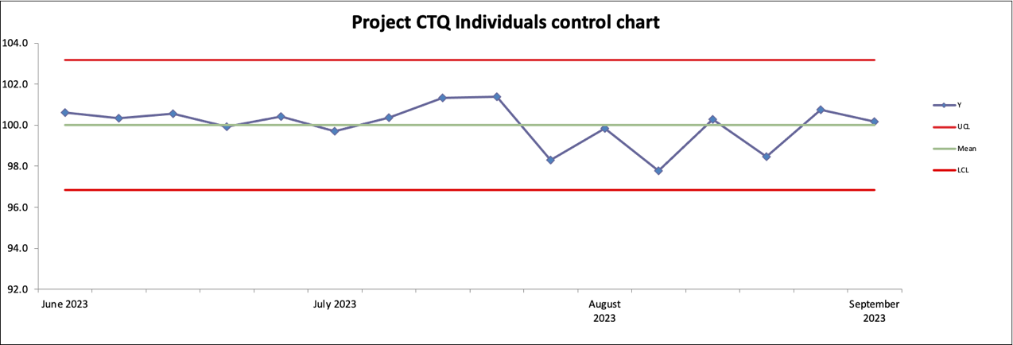
CTQ monitoring (before/after Improve & in Control)
1 CTQ monitoring
Example
Before IMPROVE
After IMPROVE – In CONTROL

Slide 6
Training plan
2 Training
Plan
Pls list below all completed trainings, attendance and date of completion:
Training name | Attendance | Date of completion
Pls list below all scheduled/in progress trainings, attendance and scheduled date:
Training name | Attendance | Scheduled Date

Slide 7
Work instruction creation / update
3 Work Instructions
Pls list below all Work instructions that were created / updated:
Work Instruction title | Reference | Author | Date of last Revision

Slide 8
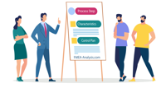
Visual Management/Production Run debrief meetings
4 Visual Management
/Production
run
debrief
Visual Management Picture
Date & time of debrief meeting | Responsible | Attendance

Slide 9
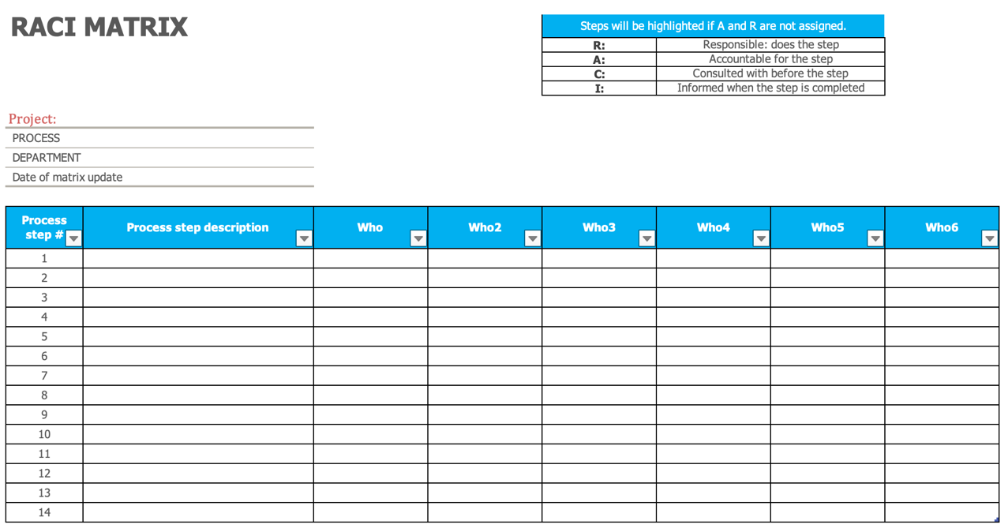
RACI update (Roles & Responsibilities)
5 RACI

Slide 10
Audit plan
6 Audit
Plan
Audit plan title | Reference | Author | Date of last Revision | Frequency | Audit date | Nbr of Non-Conformities

Slide 11
Transfer to Process Owner
Element Transferred | Process Owner Name/Responsible | Date of Transfer
Process/CTQ monitoring
Training Plan
Work Instructions
Visual Management/Production run debrief
RACI
Audit Plan
Project and Process documentation

Slide 12
Updated Business Case/Financial Analysis
Hard Benefits | FTE benefits | Soft Benefits | Project Costs

Slide 13
Next Steps

Slide 14
Lessons Learned

Slide 15


Control phase review validation
Control phase deliverables:
  Project documented
  Solutions are sustained over time
  Statistical Process Control (SPC) in place (Y monitoring)
  Control plan completed
  To Be process transferred to process owner
  Benefits tracked & approved by Finance
  Milestone reviewed & validated by Sponsor & Stakeholders
  Master Black Belt approval

Slide 16

Thank You

