Slide 1

ANALYZE phase
Project picture
Project title
Green Belt/Black Belt name:
Date

Slide 2
Project reminder
Project Context/Business Need/Alignment with Company strategy
[Describe here the context of the project]
Problem Statement
SMART Goal Statement
[What is the current Performance issue in terms of Delay, Cost, Quality? Be SMART (Specific, Measurable, Attainable, Realistic, Tangible)]
[What is the Future Performance Objective of this project in terms of Delay, Cost, Quality? Be SMART (Specific, Measurable, Attainable, Realistic, Tangible)]
In Scope
Out of Scope
[What is in scope of this project?]
[What is out of scope of this project?]

Slide 3
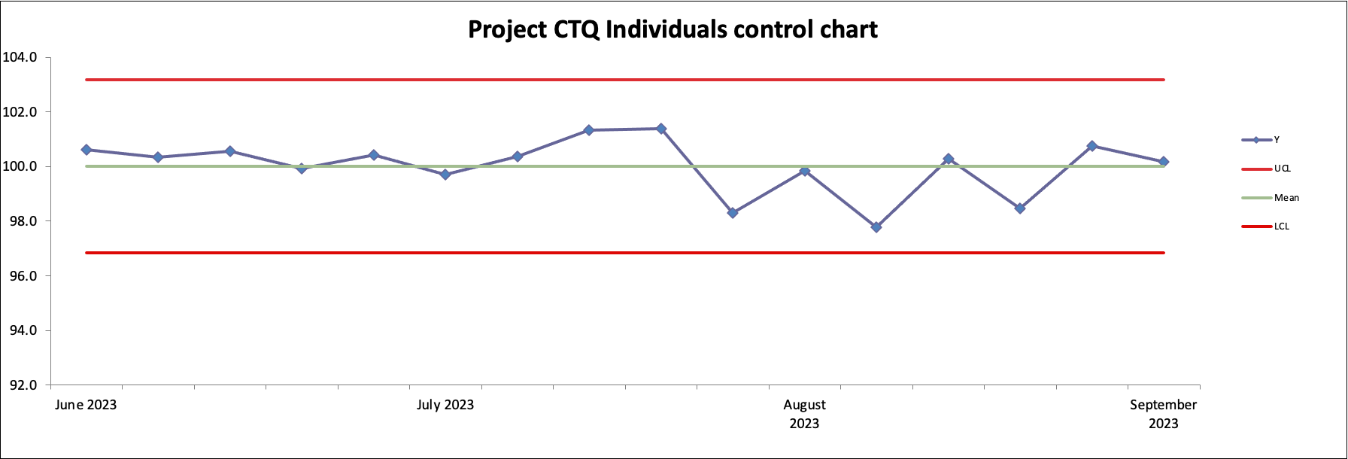
Project CTQ monitoring
Example
Note: Please mention any quick wins implemented on the control chart itself and at the corresponding date on the x scale!!

Slide 4
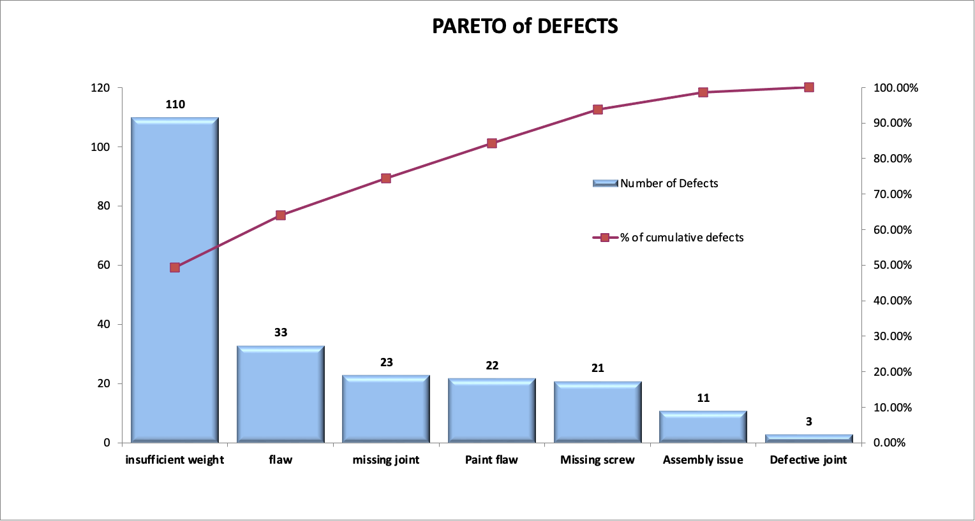
Pareto of defects
Optional
Example

Slide 5
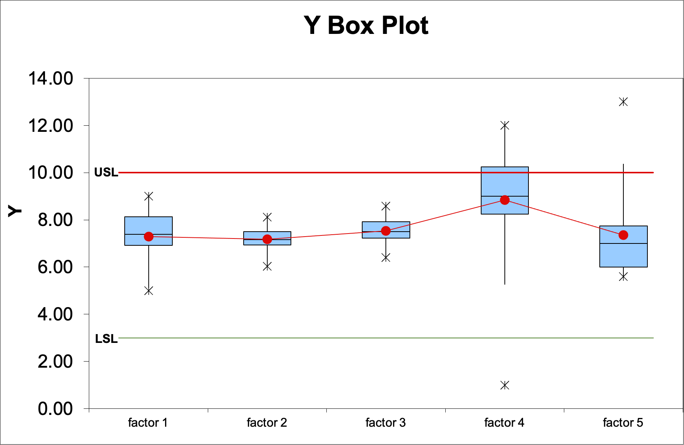
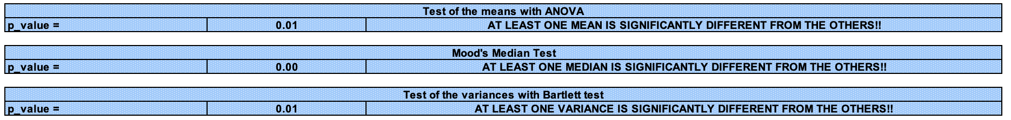
Data/CTQ stratification (continuous CTQ):
Optional
Example

Slide 6
Cause and Effect analysis (Ishikawa/fishbone diagram)
Measurement
Machine/Equipment
Men
Note: Use as many fishbones as you need (e.g., one per Pareto head or per box plot!
Failure effect
Note: Please mention any prioritization results (votes) on the fishbone itself!!
Methods
Mother Nature/
Environment
Materials

Slide 7
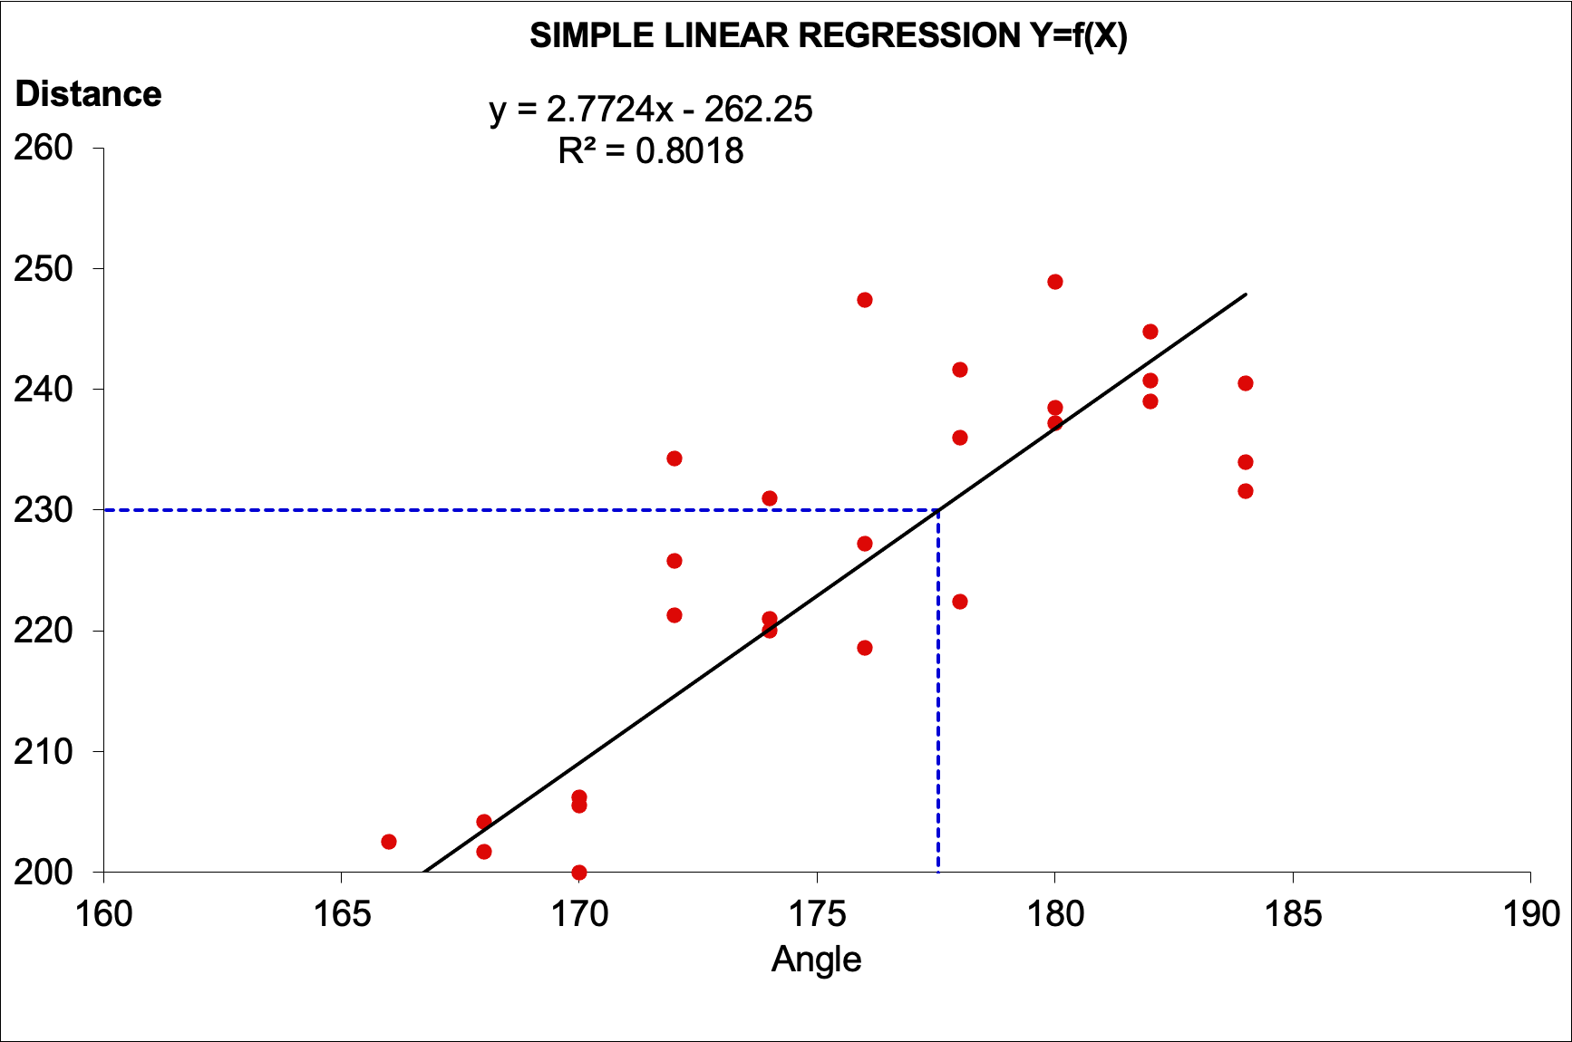
Graphical analysis/Hypothesis testing (continuous CTQ)
Examples

Slide 8
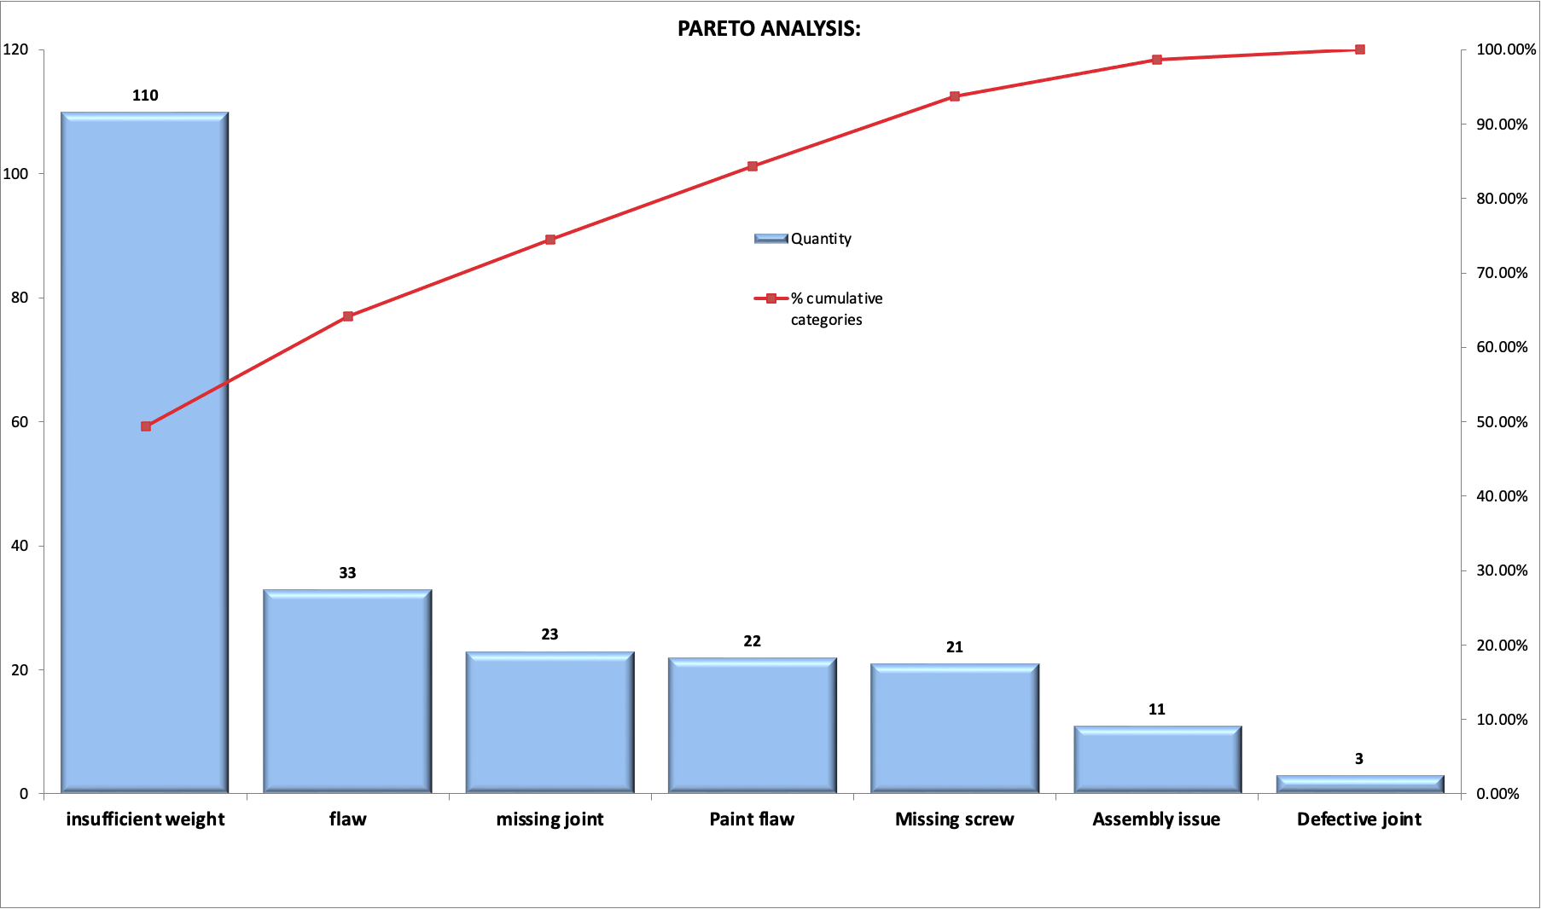
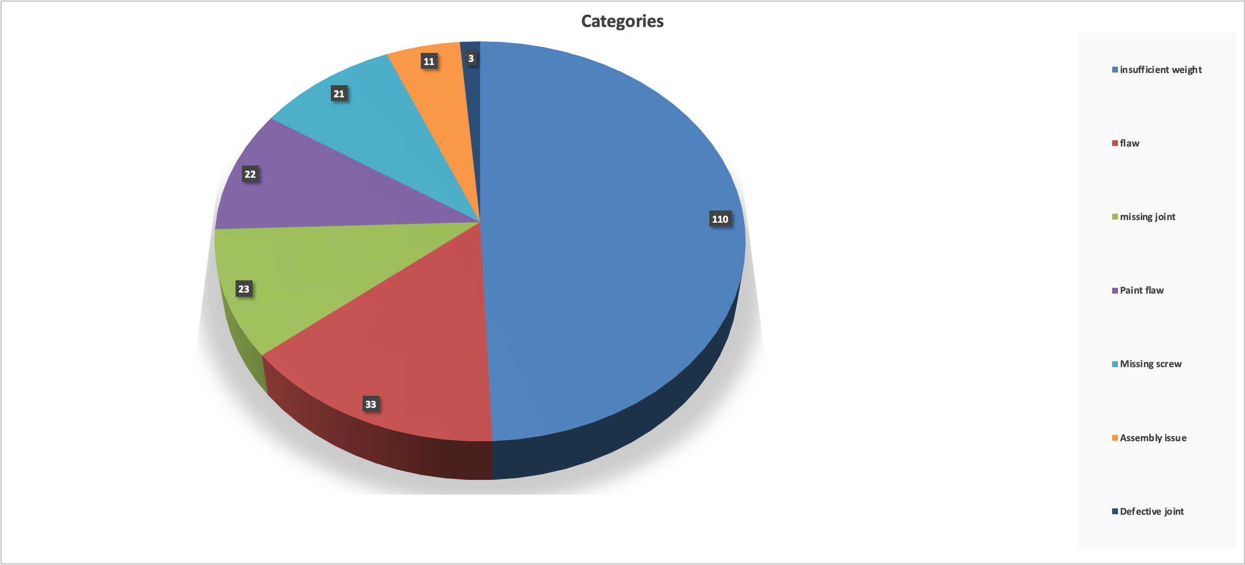
Pareto or Pie chart graphical analysis (attribute CTQ)
Examples

Slide 9
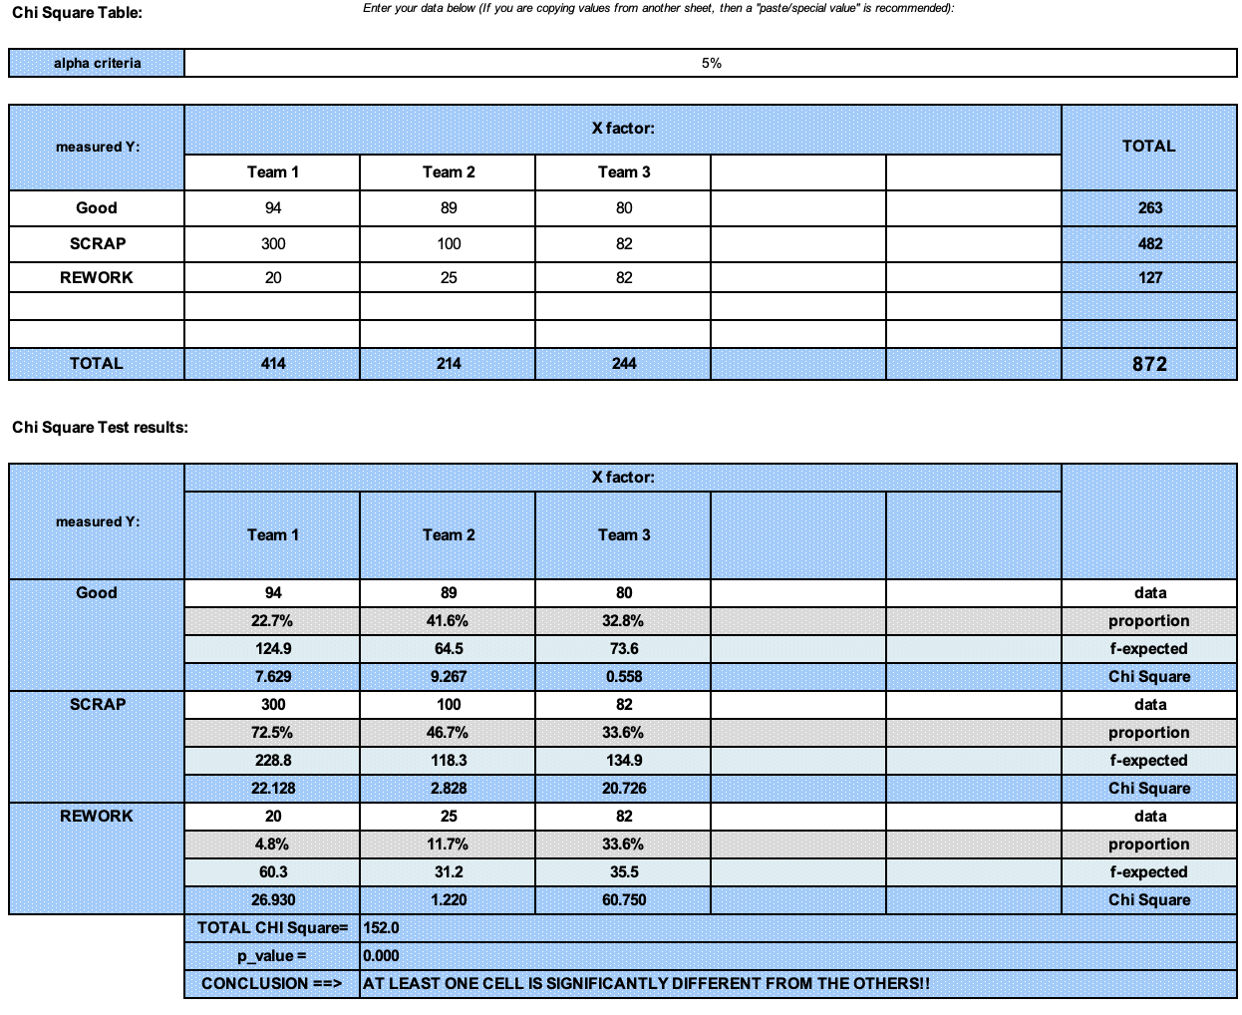
Hypothesis testing (attribute CTQ)
Example

Slide 10
Analysis summary/ Critical root causes by priority
Example

Slide 11
Updated Business Case/Financial Analysis (optional)
Hard Benefits over a 12-month period:
Assumptions made:
FTE (Full Time Equivalent) Benefits:
Assumptions made:
Soft Benefits Benefits:
Assumptions made:
Project anticipated costs:
Assumptions made:

Slide 12
Next Steps

Slide 13
End

